Slide 1
The Study of Pandemic Spread Based on Spatiotemporal Data
Zhiqian Chen
Mississippi State University
zchen@cse.msstate.edu

Slide 2
Agenda - temporal change model
Traditional Methods in Epidemiology
Susceptible-Infected-Recovered (SIR) – like models
Graph Neural Networks for Epidemiology
Basics of GNN
Spatio-Temporal GNN
Forward problem: forecast
Inverse problem: zero-patient
GNN, SIR and PDE
Open Problems

Slide 3
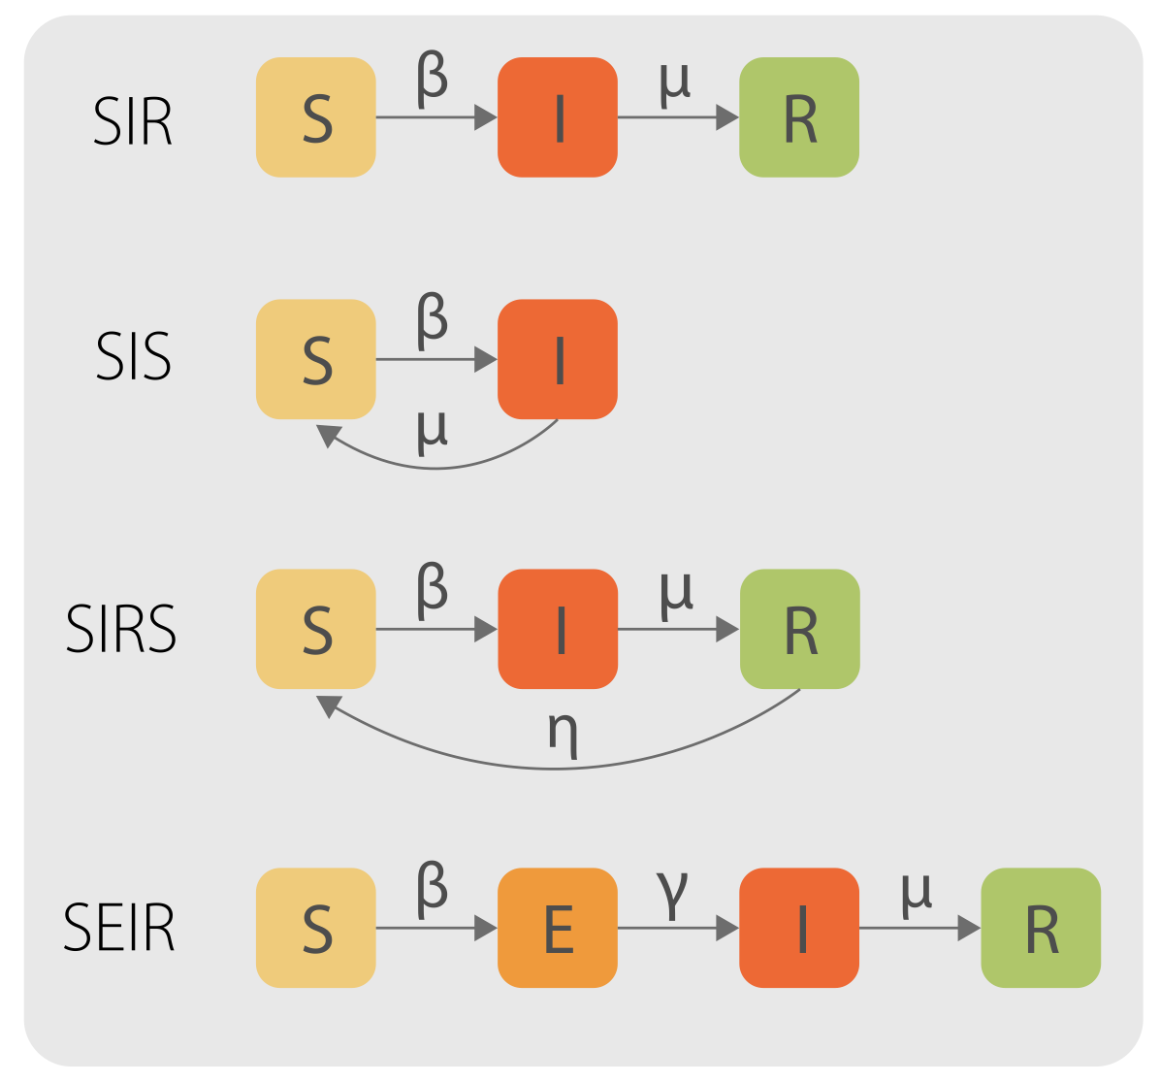
Epidemiology Models
S: Susceptible
I: Infectious
R: Recovered
E: Exposed
Pastor-Satorras, Romualdo, Claudio Castellano, Piet Van Mieghem, and Alessandro Vespignani. "Epidemic processes in complex networks." Reviews of modern physics 87, no. 3 (2015): 925.

Slide 4
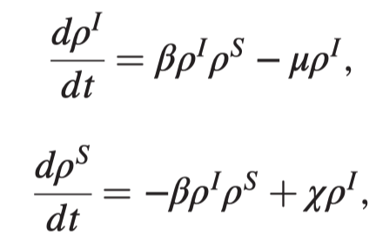
Traditional Methods in Epidemiology
Pastor-Satorras, Romualdo, Claudio Castellano, Piet Van Mieghem, and Alessandro Vespignani. "Epidemic processes in complex networks." Reviews of modern physics 87, no. 3 (2015): 925.

Slide 5
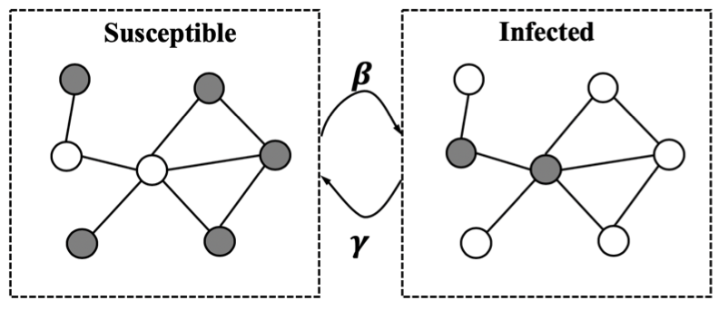
Graph Neural Networks for Epidemiology
SIR-like models
[+] temporal diffusion
[-] Ignore connectivity
Graph neural networks (GNN)
[+] Characterize connectivity
[-] Lack temporal diffusion
GNN + RNN
Connectivity + Temporal

Slide 6
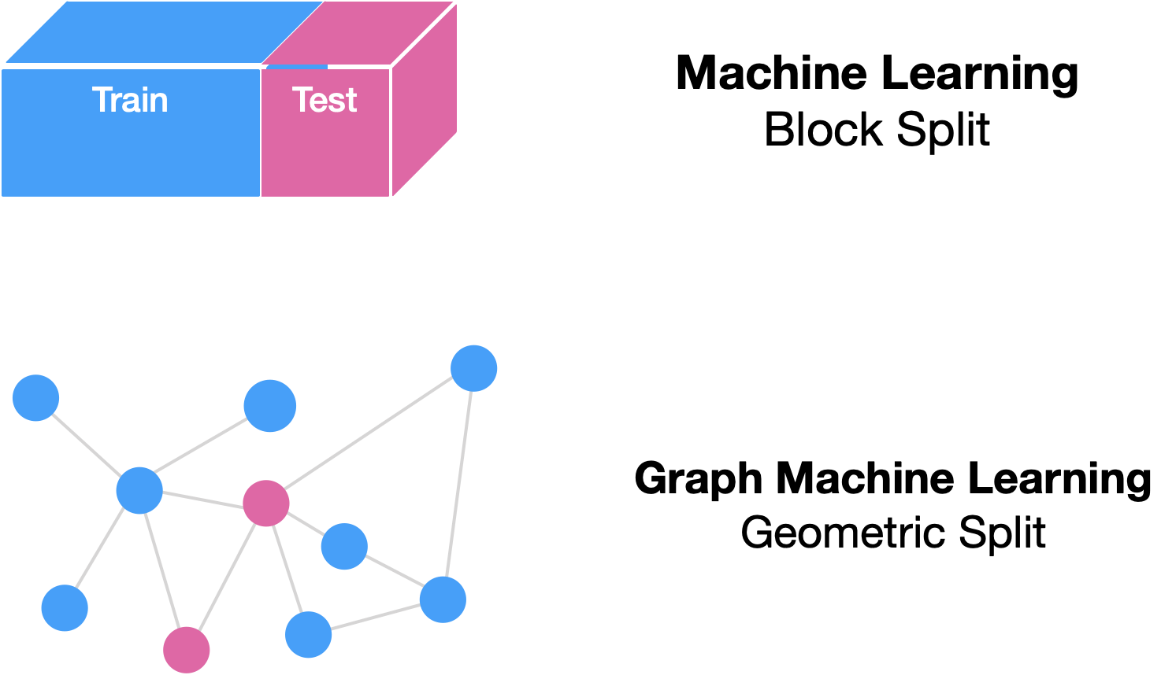
Basics of GNN

Slide 7
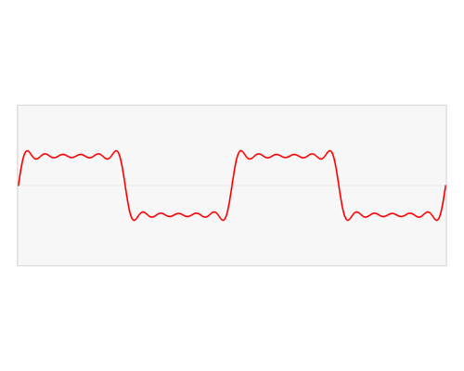
Basics of GNN
Spectral Decomposition
Img Source

Slide 8
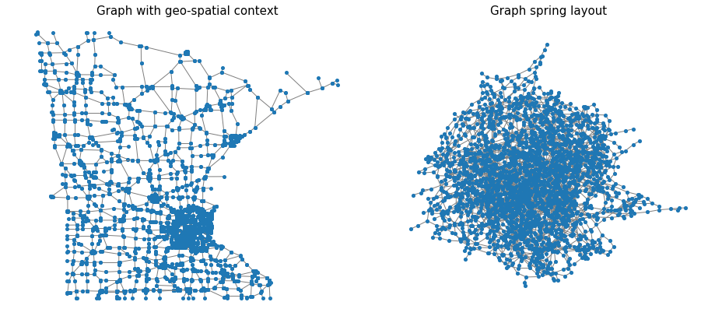
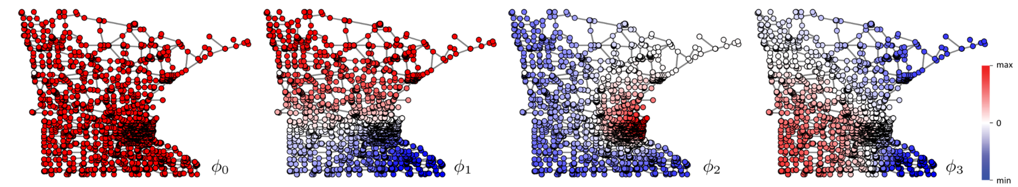
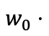
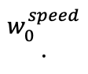
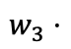
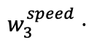
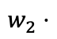
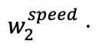
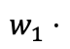
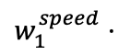
Basics of GNN
Graph Structure
Graph Signal (e.g.,Traffic Speed)
Minnesota Road Networks
$$w_{0}^{speed}⋅$$
$$w_{0}⋅$$
$$w_{1}⋅$$
$$w_{1}^{speed}⋅$$
$$w_{2}⋅$$
$$w_{2}^{speed}⋅$$
$$w_{3}⋅$$
$$w_{3}^{speed}⋅$$
eigen-vector 0
eigen-vector 1
eigen-vector 2
eigen-vector 3
Graph Fourier Transform (Spectral Decomposition)
8

Slide 9
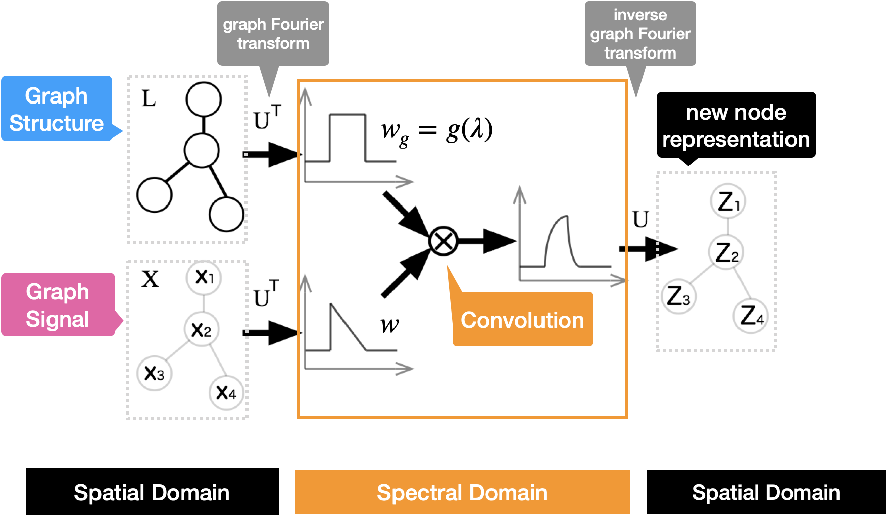
Basics of GNN

Slide 10
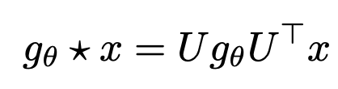
Basics of GNN
Graph Structure
Graph Signal (e.g.,Traffic Speed)
1
graph Fourier transform
2
convolution (theorem)
3
Inverse graph Fourier transform

Slide 11
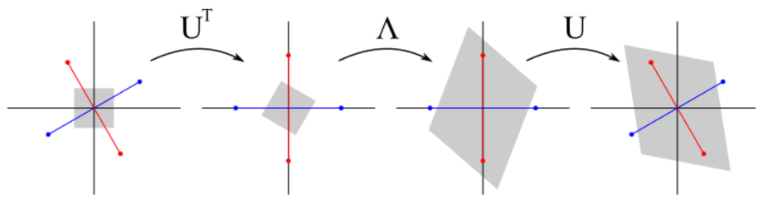
Basics of GNN
Geometric Interpretation of Graph Fourier Transform
Img Source

Slide 12
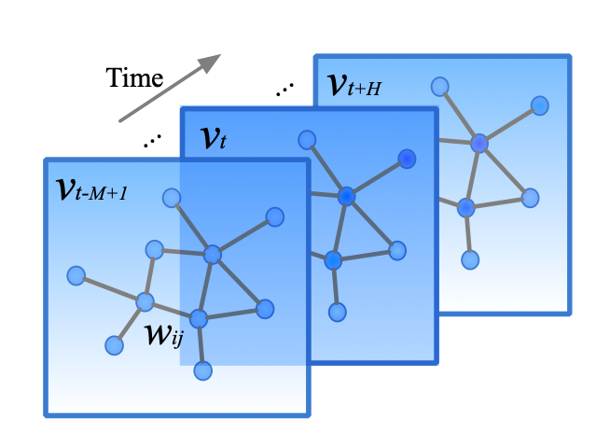
Spatio-Temporal GNN
GNN for spatial neighbors
RNN for temporal neighbors (itself)
Options:
GNN + RNN
RNN + GNN
Yu, Bing, Haoteng Yin, and Zhanxing Zhu. "Spatio-temporal graph convolutional networks: A deep learning framework for traffic forecasting." arXiv preprint arXiv:1709.04875 (2017).

Slide 13
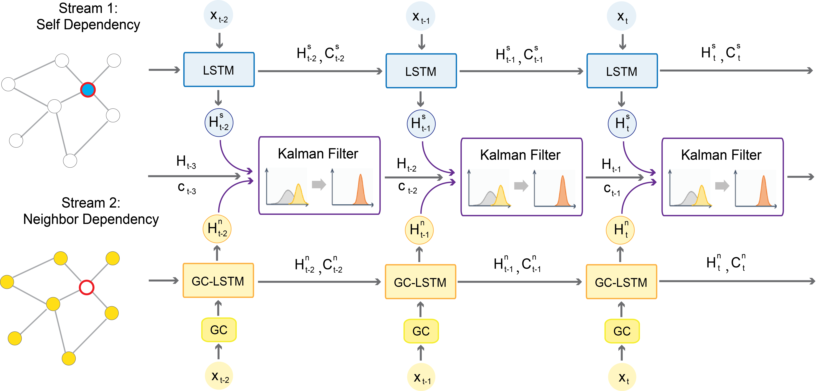
Spatio-Temporal GNN
Learn weights by their variances: balance information with variance
Chen, Fanglan, Zhiqian Chen, Subhodip Biswas, Shuo Lei, Naren Ramakrishnan, and Chang-Tien Lu. "Graph Convolutional Networks with Kalman Filtering for Traffic Prediction." In Proceedings of the 28th International Conference on Advances in Geographic Information Systems, pp. 135-138. 2020.
Jiang, Weiwei, and Jiayun Luo. "Graph Neural Network for Traffic Forecasting: A Survey." arXiv preprint arXiv:2101.11174(2021).

Slide 14
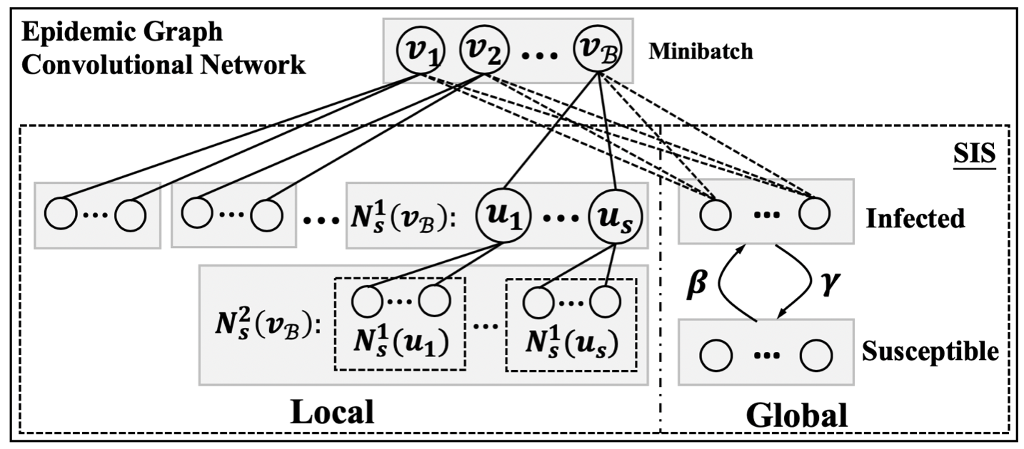
GNN for Epidemiology
Forecast
Derr, Tyler, Yao Ma, Wenqi Fan, Xiaorui Liu, Charu Aggarwal, and Jiliang Tang. "Epidemic graph convolutional network." In Proceedings of the 13th International Conference on Web Search and Data Mining, pp. 160-168. 2020.

Slide 15
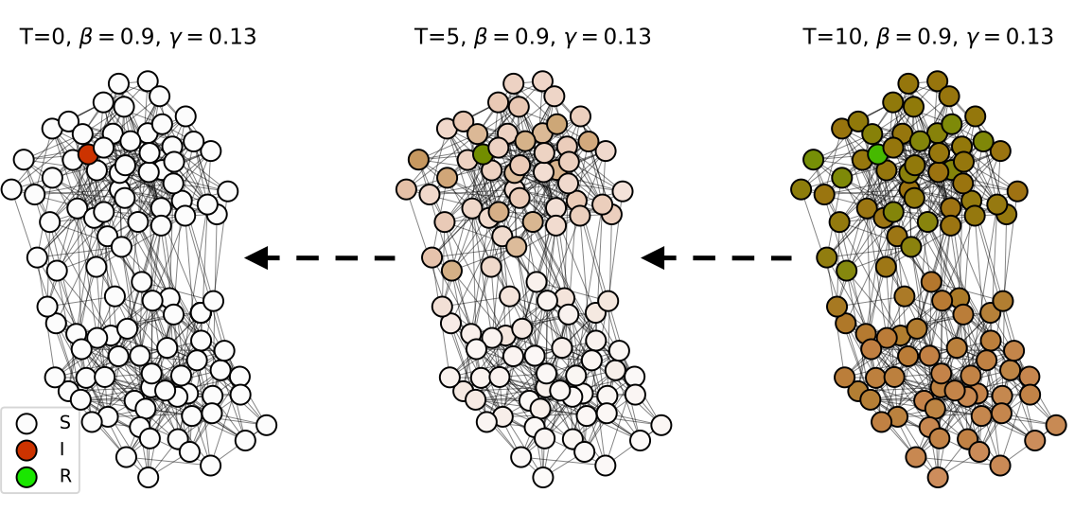
GNN for Epidemiology
Finding Patient Zero
Use GNN to learn Reaction-Diffusion (RD)
Shah, Chintan, Nima Dehmamy, Nicola Perra, Matteo Chinazzi, Albert-László Barabási, Alessandro Vespignani, and Rose Yu. "Finding Patient Zero: Learning Contagion Source with Graph Neural Networks." arXiv preprint arXiv:2006.11913(2020).

Slide 16
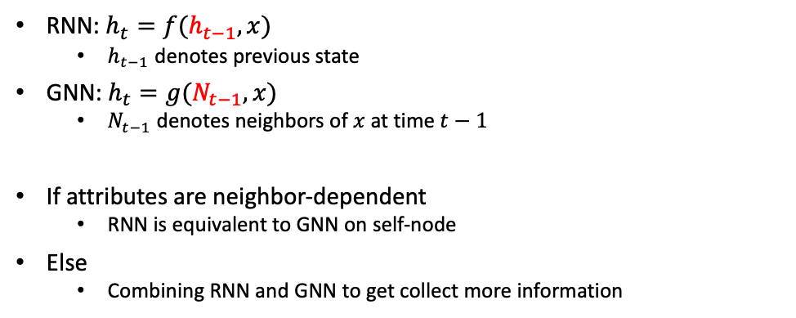
GNN, RNN, SIR and PDE
RNN: $h_{t}=f(h_{t−1}, x)$
$h_{t−1}$ denotes previous state
GNN: $h_{t}=g(N_{t−1}, x)$
$N_{t−1}$ denotes neighbors of $x$ at time $t−1$
If attributes are neighbor-dependent
RNN is equivalent to GNN on self-node
Else
Combining RNN and GNN to get collect more information

Slide 17
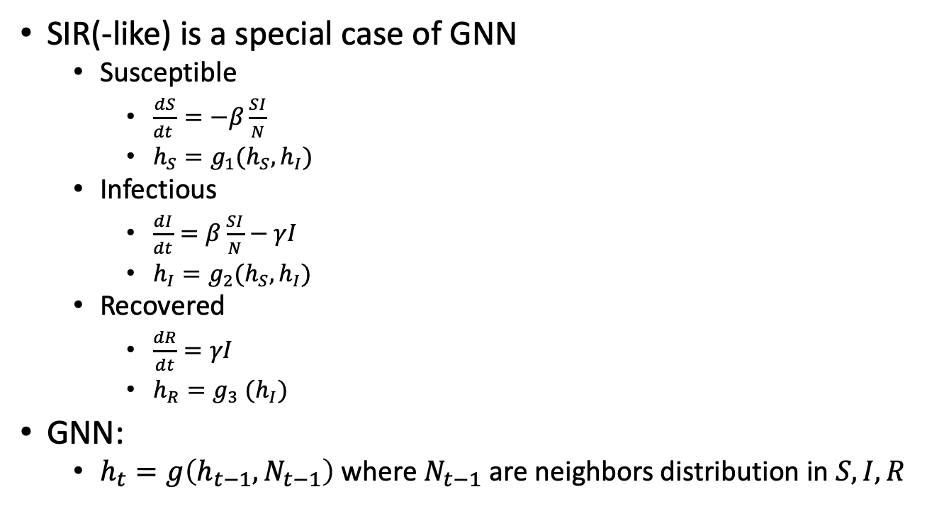
GNN, RNN, SIR and PDE
SIR(-like) is a special case of GNN
Susceptible
$\frac{dS}{dt }=−β\frac{SI}{N}$
$h_{S}=g_{1}(h_{S}, h_{I})$
Infectious
$\frac{dI}{dt}=β\frac{SI}{N}−γI$
$h_{I}=g_{2}(h_{S}, h_{I})$
Recovered
$\frac{dR}{dt}=γI$
$h_{R}=g_{3} (h_{I})$
GNN:
$h_{t}=g\left(h_{t−1}, N_{t−1}\right)$ where $N_{t−1}$ are neighbors distribution in $S, I, R$

Slide 18
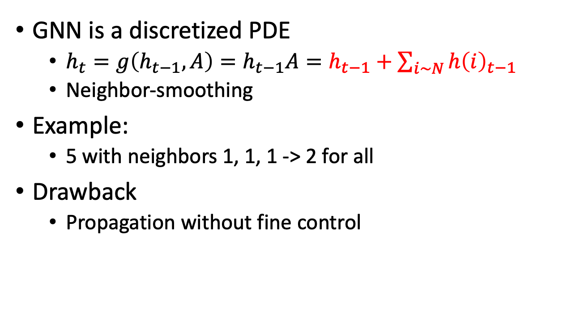
GNN, RNN, SIR and PDE
GNN is a discretized PDE
$h_{t}=g\left(h_{t−1}, A\right)=h_{t−1}A=h_{t−1}+\sum_{i\sim N}{h{\left(i\right)}_{t−1}}$
Neighbor-smoothing
Example:
5 with neighbors 1, 1, 1 -> 2 for all
Drawback
Propagation without fine control
1
1
5
1
2
2
2
2

Slide 19
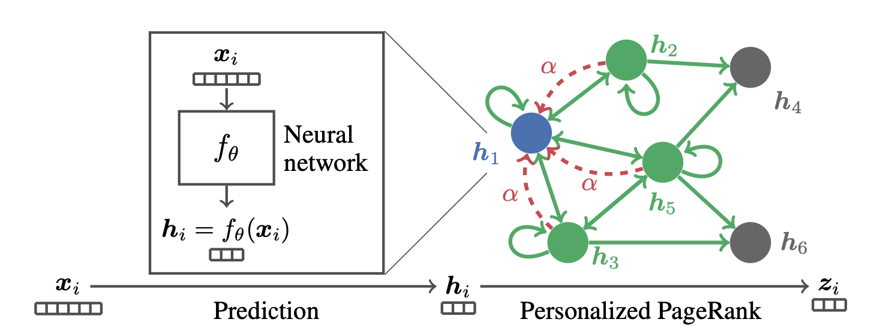
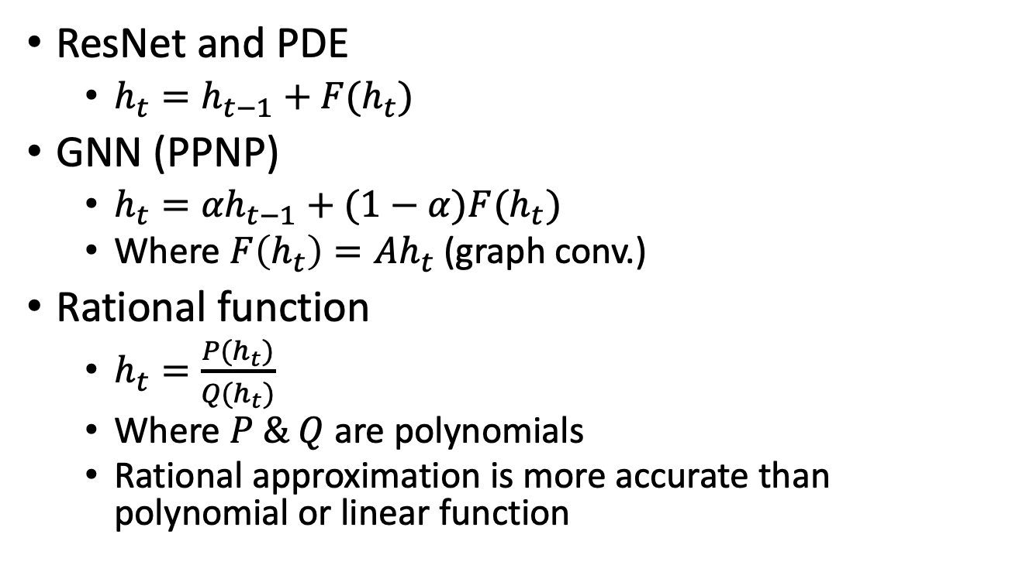
GNN, RNN, SIR and PDE
ResNet and PDE
$h_{t}=h_{t−1}+F(h_{t})$
GNN (PPNP)
$h_{t}={αh}_{t−1}+(1−α)F(h_{t})$
Where $F\left(h_{t}\right)=Ah_{t}$ (graph conv.)
Rational function
$h_{t}=\frac{P(h_{t})}{Q(h_{t})}$
Where $P \& Q$ are polynomials
Rational approximation is more accurate than polynomial or linear function
Klicpera, Johannes, Aleksandar Bojchevski, and Stephan Günnemann. "Predict then propagate: Graph neural networks meet personalized pagerank." arXiv preprint arXiv:1810.05997(2018).
Bianchi, Filippo Maria, Daniele Grattarola, Lorenzo Livi, and Cesare Alippi. "Graph neural networks with convolutional arma filters." IEEE Transactions on Pattern Analysis and Machine Intelligence (2021).

Slide 20

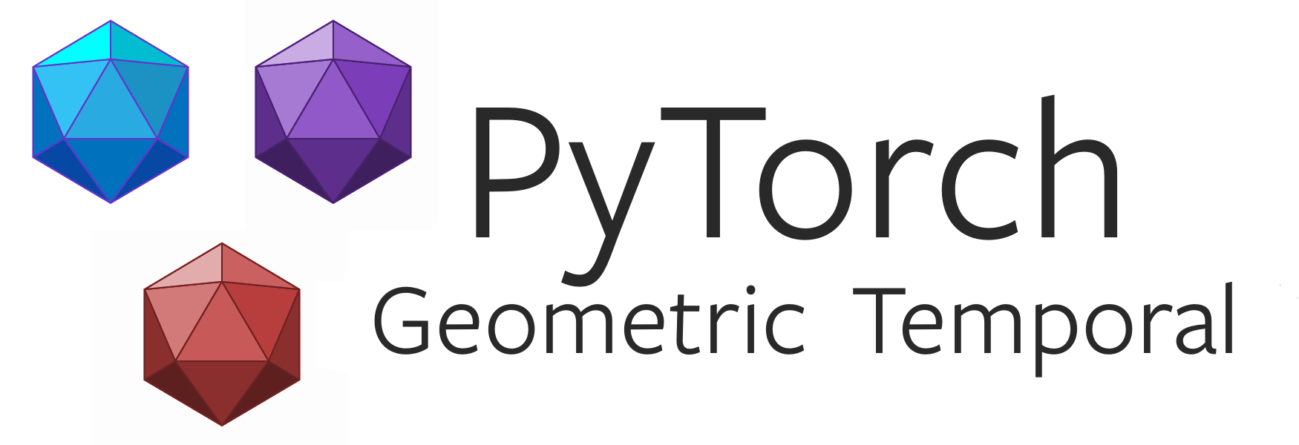
Implementation
Diffusion of Epidemics
Independent cascade
Linear threshold
SIR, SIS, SEIR etc.
PyTorch Geometric Temporal
STGCN
T-GCN
GC-LSTM
DCRNN

Slide 21
Open Problems
Over-smoothing v.s. Long-term dynamics
Information disappears after several GNN layers
GNN w/ RNN models at most long-short term
Continuous and discretized propagation
One GNN layer conduct one discretized propagation
Temporal Networks
Topology changes along the time
Digraph or DAG
Most of GNN focus on undirected graph

Slide 22
Reference
Chang, Serina, Emma Pierson, Pang Wei Koh, Jaline Gerardin, Beth Redbird, David Grusky, and Jure Leskovec. "Mobility network models of COVID-19 explain inequities and inform reopening." Nature 589, no. 7840 (2021): 82-87.
Pastor-Satorras, Romualdo, Claudio Castellano, Piet Van Mieghem, and Alessandro Vespignani. "Epidemic processes in complex networks." Reviews of modern physics 87, no. 3 (2015): 925.
Yu, Bing, Haoteng Yin, and Zhanxing Zhu. "Spatio-temporal graph convolutional networks: A deep learning framework for traffic forecasting." arXiv preprint arXiv:1709.04875 (2017).
Chen, Fanglan, Zhiqian Chen, Subhodip Biswas, Shuo Lei, Naren Ramakrishnan, and Chang-Tien Lu. "Graph Convolutional Networks with Kalman Filtering for Traffic Prediction." In Proceedings of the 28th International Conference on Advances in Geographic Information Systems, pp. 135-138. 2020.
Jiang, Weiwei, and Jiayun Luo. "Graph Neural Network for Traffic Forecasting: A Survey." arXiv preprint arXiv:2101.11174(2021).
Derr, Tyler, Yao Ma, Wenqi Fan, Xiaorui Liu, Charu Aggarwal, and Jiliang Tang. "Epidemic graph convolutional network." In Proceedings of the 13th International Conference on Web Search and Data Mining, pp. 160-168. 2020.

Slide 23
Reference
Shah, Chintan, Nima Dehmamy, Nicola Perra, Matteo Chinazzi, Albert-László Barabási, Alessandro Vespignani, and Rose Yu. "Finding Patient Zero: Learning Contagion Source with Graph Neural Networks." arXiv preprint arXiv:2006.11913(2020).
Saha, Pritam, Debadyuti Mukherjee, Pawan Kumar Singh, Ali Ahmadian, Massimiliano Ferrara, and Ram Sarkar. "GraphCovidNet: A graph neural network based model for detecting COVID-19 from CT scans and X-rays of chest." Scientific Reports 11, no. 1 (2021): 1-16.
Panagopoulos, George, Giannis Nikolentzos, and Michalis Vazirgiannis. "Transfer Graph Neural Networks for Pandemic Forecasting." (2020).
Kapoor, Amol, Xue Ben, Luyang Liu, Bryan Perozzi, Matt Barnes, Martin Blais, and Shawn O'Banion. "Examining covid-19 forecasting using spatio-temporal graph neural networks." arXiv preprint arXiv:2007.03113 (2020).
Gao, Junyi, Rakshith Sharma, Cheng Qian, Lucas M. Glass, Jeffrey Spaeder, Justin Romberg, Jimeng Sun, and Cao Xiao. "STAN: spatio-temporal attention network for pandemic prediction using real-world evidence." Journal of the American Medical Informatics Association 28, no. 4 (2021): 733-743.
Yu, Xiang, Siyuan Lu, Lili Guo, Shui-Hua Wang, and Yu-Dong Zhang. "ResGNet-C: A graph convolutional neural network for detection of COVID-19." Neurocomputing (2020).

Slide 24
Reference
Alet, Ferran, Adarsh Keshav Jeewajee, Maria Bauza Villalonga, Alberto Rodriguez, Tomas Lozano-Perez, and Leslie Kaelbling. "Graph element networks: adaptive, structured computation and memory." In International Conference on Machine Learning, pp. 212-222. PMLR, 2019.
Li, Zongyi, Nikola Kovachki, Kamyar Azizzadenesheli, Burigede Liu, Kaushik Bhattacharya, Andrew Stuart, and Anima Anandkumar. "Multipole graph neural operator for parametric partial differential equations." arXiv preprint arXiv:2006.09535 (2020).
Klicpera, Johannes, Aleksandar Bojchevski, and Stephan Günnemann. "Predict then propagate: Graph neural networks meet personalized pagerank." arXiv preprint arXiv:1810.05997(2018).

